Slide 1


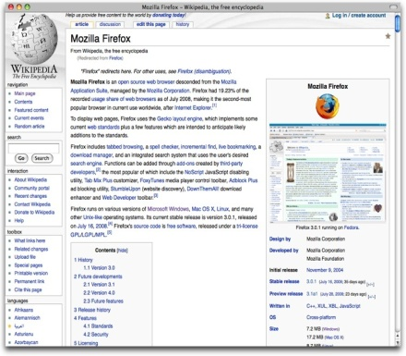
BE Project on VOICE WIKIPEDIA
By
Nelson Dsouza
Guide-Prof. Anup Kunte
Co-Guide-Prof. Ashwini Borle

Slide 2

Knowledge is Power
Today’s day and age can safely be called the “Information Age”
It was once said by Churchill that “In the future, wars will not be won by weapons, but by information”
The Future has arrived

Slide 3
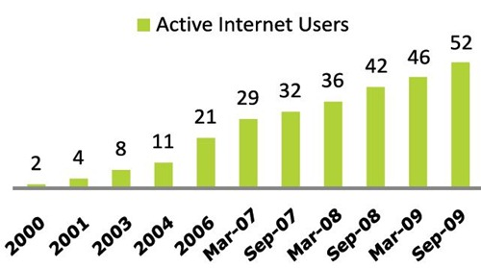
Internet Growth
Internet offers cheap and easily accessible means of information
Provides a direct global
communication channel
to rural areas through
the largest growing
source of knowledge.

Slide 4
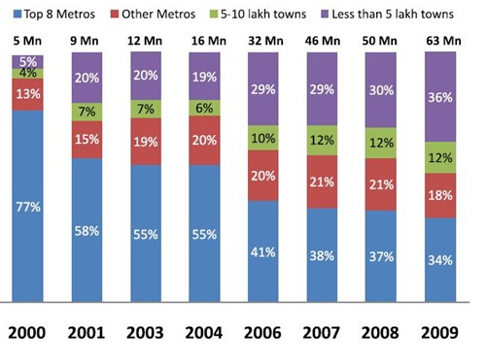
India’s Competency
The metropolis shows high users, but its still 70% of the villages that are lagging far behind
DNA survey shows that 80% village folks unaware of the mediums existence

Slide 5


Why Internet awareness & usage so less compared to mobile ?
India is still a developing country with more than 700 million villagers
Mobile’s are cheap while internet cost aren't
Low broadband penetration in rural areas
Internet Infrastructure not well developed

Slide 6
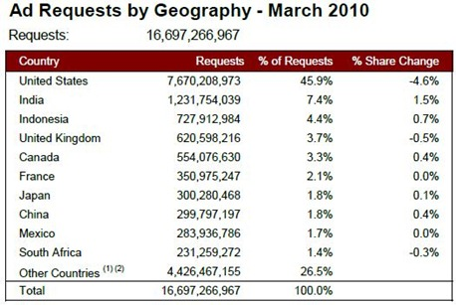
The mobile growth…
India added 17 million subscribers in July 2010, taking the total number to 652 million, (TRAI).
India's mobile subscribers to top 35 crore by 2010

Slide 7


…and Growth
India is a country with more mobile phones than toilets
Most rural mobile users cant access internet on mobile due to lack of coverage
or support
About 55 out of every 100 Indians now owns a mobile phones

Slide 8
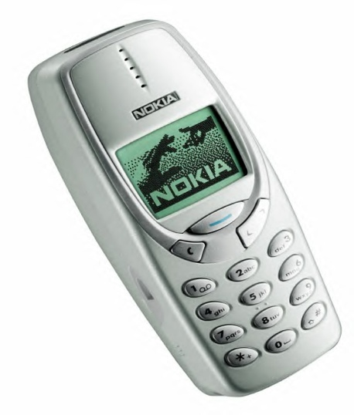




Can we bridge this knowledge vs infrastructure gap?
All low end mobile phones are SMS enabled
Internet is a pool of open source knowledge
By using the basic SMS facility of mobile phone in to the tap the enormous power of the internet, we can bridge the gap

Slide 9
Main Objective
Information should be available regardless of infrastructure (internet penetration) or affordability (cost of GPRS phones)
Urban vs Rural a divide should be reduced, wherein rural areas, hosting majority of the population are the most ignorant
Use of the most common devices available (mobile phone) to make information accessible to all

Slide 10
Summarizing how to solve information isolation
User need have only a basic mobile phone with SMS sending facility
The SMS when sent to a automated server must process it,and find the information over the internet
This information should be returned to the user

Slide 11
Assigning Boundaries or information search
The internet is a huge and searching the whole of it for information is illogical and un-feasible
Information preferably should be searched from only one site which will lead to uniformity
That particular site must have a huge resource pool to give information over wide range
Such a site would be WIKIPEDIA

Slide 12

Why Wikipedia ?
It is open source (free)
Gives quick search results
Has a constant format
Huge Database
Regularly updated
Reliable

Slide 13
What format should the output be in ?
If output is in SMS (text) format, it becomes cumbersome to read
Wikipedia entries too large to be SMS’ed
Only other output format supported by all mobile phones is Voice
Voice is pleasant to hear and can be received in groups

Slide 14
Compiling…
Rural India and people who cant afford GPRS or aren’t provided internet infrastructure have right to information.
Most common & basic devices with all people are mobile phones with SMS facility
Designing an automated server which accepts user SMS as keyword and searches relevant wiki page for information
This information to be relayed back in Speech format

Slide 15
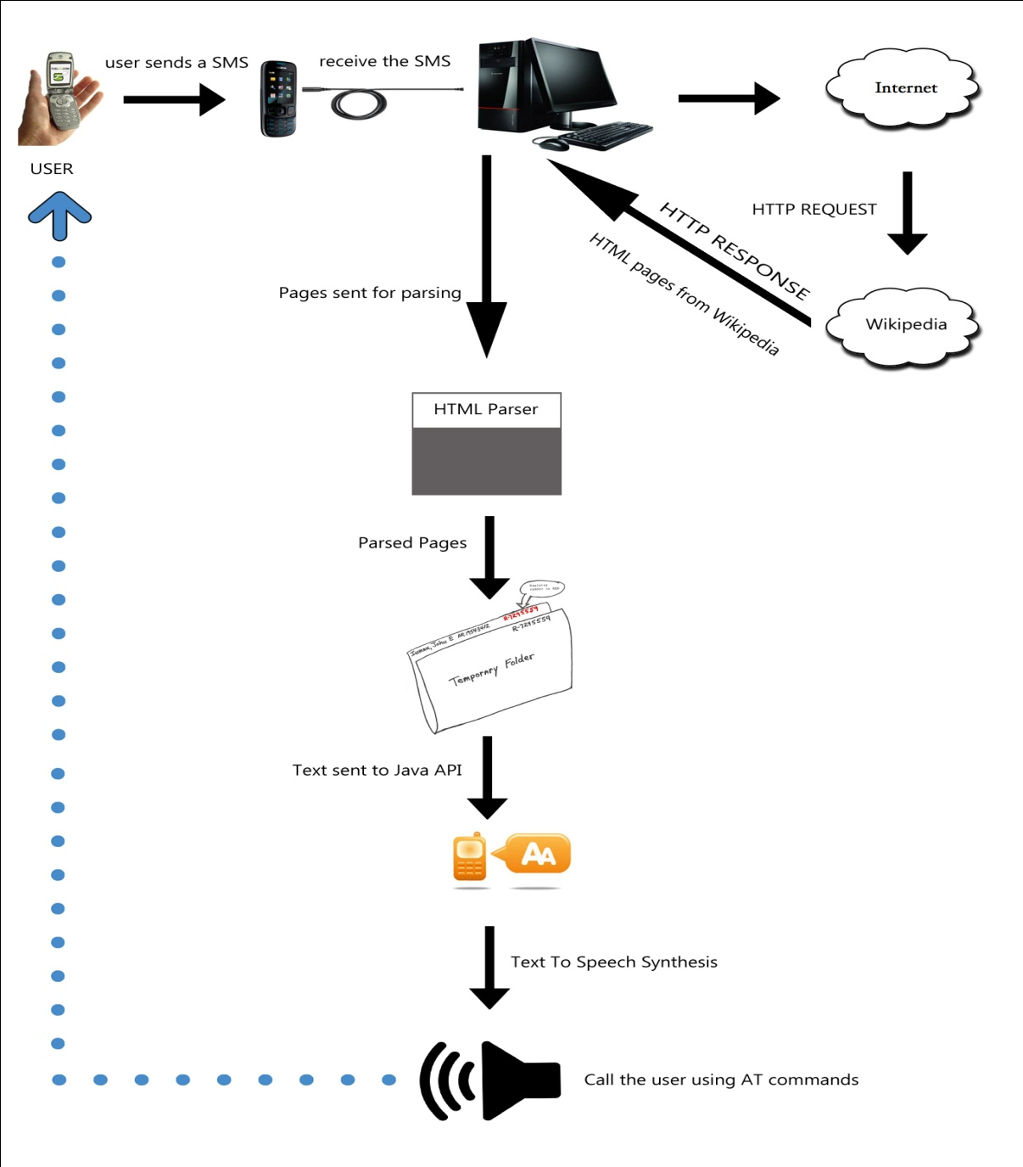
Moving from WHY to HOW ! !
The
Complete
Block

Slide 16
Part 1- Sending the SMS
The user needs to type the word which they wish to gain information about. eg:- Constitution
This Keyword will be SMS’ed to a number assigned to the server
The keyword need not be case-sensitive because it is not a necessity for Wikipedia search
For ambiguous words, extra information should be supplied in braces
eg:- Mercury (planet) OR Mercury(element)

Slide 17
Part 2 Receiving the SMS
The server will be connected to a mobile device on whose number the SMS will be received
SMS to be received by the server and the keyword to be extracted using AT commands
This keyword will now be stored in a file ready to be inserted into Wikipedia

Slide 18
Part 3- Searching the information
The keyword which is extracted will now be searched by the server on Wikipedia
The page which is obtained will now be converted into HTML format with the help of a snippet
The HTML output should be in standard format with heading, summary, in-depth details.
If it is not, a error message will be sent to user

Slide 19
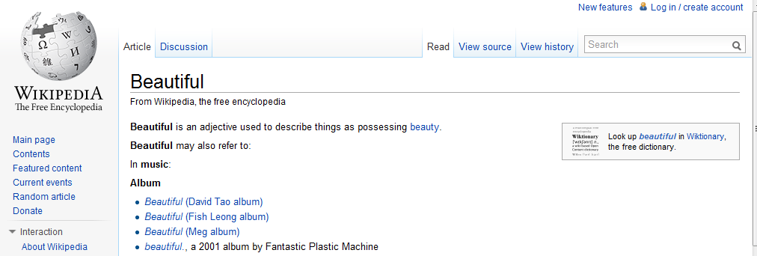
Chance of error
90 % of Wikipedia searches are Nouns which are unique and hence there is very less scope for ambiguity
The very few adjectives that are searched almost always give a further list of words to be chosen from
Eg:- for adjective beautiful, we get a list like

Slide 20
Scope of error
Errors are generated if
1. User enters wrong spelling
2.No such word exists in the database
3. The word is ambiguous

Slide 21
Tackling with errors
The first two errors are user mistakes and cant be dealt by server
However if the word is ambiguous, there will be an alert to the user to enter property in braces and resend SMS
OR
Default i.e. first entry in the list can be considered automatically

Slide 22
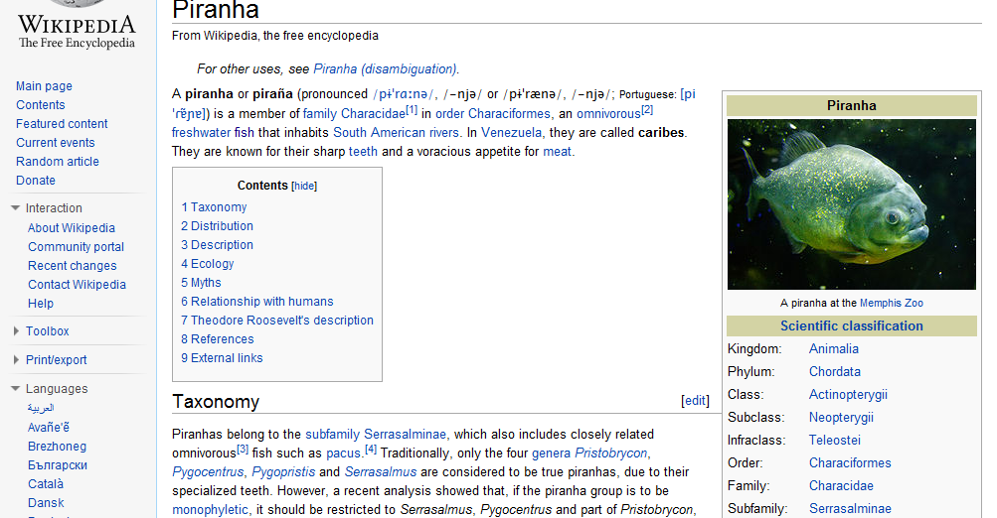
Format of Standard result page
Title
Summary
Description List
Main Description

Slide 23
Problems in parsing whole page
It will contain a lot of information which will become cumbersome for the user to listen
Conversion of such a lot of text into speech will take a lot of time
Most of the times the main information is contained only in the summary
After testing 30 words we saw that summary contains 240-280 words, hence ideal to convert while it still has the necessary information

Slide 24
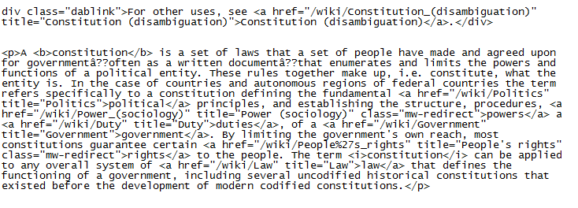
HTML O/P of wiki page Summary
Consider the keyword – CONSTITUTION
The HTML output of summary of keyword obtained by snippet would be like this

Slide 25
Part 4- Parsing the information
The summary we have obtained in HTML format will now be parsed
This is done to eliminate the tags and to keep only the relevant summary
This parsing will be done by manipulating strings through java
The final parse will contain only that information which is to be converted in speech

Slide 26
Part 5 –Converting the information
We now have the text which the user had requested and now need to convert it into speech
Text to speech conversion is to be done in java using the java speech API
Functions of the Java API are applied to the text that needs to be converted

Slide 27
Options in Java Speech API
This Speech API has been tested to conclude that the speech has a continuous flow to it
In addition a number of option for voice such as pitch, volume, sharpness ,etc
The quality is similar to the narrator voice output in Microsoft windows OS
The converted Audio file is stored in temporary storage

Slide 28
Maintaining Database Cache
For quick access of frequently SMS’ed words a database is used which stores the Summary content in FIFO manner
Currently there is possibility of storing either the summary text file or the summary audio file in DB. Only testing will tell which is better.
Since a wiki search page almost never exceeds size of 10 KB and assuming there are 500 hits per day, a cache of 5 MB can be maintained

Slide 29
Part 6 - Relay information to user
After the server is equipped with the final output of summary audio, it will contact back the user
This is again done using AT command to dial a call from the same number that SMS came
Once the user receives the call, he can listen to the wiki-page audio summary of the information he requested.

Slide 30
Role of application
Quick and concise information without need of internet access at client side
Information for the visually impaired and illiterate
Many individuals can listen to information at once
Stop-gap arrangement to maintain flow of knowledge till broadband penetrates rural regions

Slide 31
Specifications
Platform- Open Source
Language- Java
Hardware- GSM enabled mobile, server, internet access at server side
SMS enabled mobile at client side

Slide 32

Thank You ! !
Queries ?

